Slide 1
MANAGEMENT OF COMPUTERS
BY A.MVULA

Slide 2
HARDWARE INSTALLATION
Setting up computer is very important before carrying out any activity. The following precautions should be observed
All devices should disconnect from power source before starting to work on them.
You must be guided by your ICT trainer working on peripheral devices.
Never work alone because you may need help in case of emergency.
You must discharge any static electricity that might have built in the hands by touching the earthed metallic object and then wearing an antistatic wrist member. The human body can hold 200 volts of static charge that can damage sensitive components on the mother bold.

Slide 3
Tools and other requirements when connecting computers hardware
The tools required include:
Screw drivers
Antistatic wrist member
Pliers
Device manuals
Device software ( drivers )

Slide 4
Mounting internal devices
External devices are connected to the motherboard through ports and internal devices are connected through SLOTS and SOCKETS . study the device manual carefully before connecting the internal and external devices.
When connecting the internal components note the following;
Power supply – it receives AC power from the wall socket and converts it to 12 volts DC power cables needed by computer components.
Power cables – provide power to system unit components.
Optical disk drive – used to read / write data from or to optical disk.
Hard disk – used to store computer programs and data for a long time.
Data cables – enable exchange of data between components.

Slide 5
Motherboard – used to interconnect all devices, chips and components with copper circuit drawn on it.
Expansion lots – helps when adding new device to the computer such as TV card, network card E.t.c
Interface ports – enables connection of peripheral devices such as mouse, keyboard e.t.c
Memory slots – enables installation of RAM chips on the motherboard.
Chips – have processing logic and firmware needed for correcting functioning of the computer

Slide 6
Mounting hard drives and optical drives
Special ribbon cables are used to correct computer components on the motherboard. Hard disk and optical drive are connected on the motherboard through interface connectors referred to as controllers.
Types of controllers
Enhancement Integrated Drive Electronic (EIDE).
Serial advanced Technology Attached (SATA).
Small Computer System Interface (SCSI)

Slide 7
NB: SATA has replaced EIDE, ATA and PATA. SATA is more efficient and support hotswapping. Hot-swapping means that the drive can be removed or inserted while the computer is still on. SATA and EIDE are the common controllers used in most computers.

Slide 8
Steps to be followed when mounting an EIDE or SATA Hard drive.
To mount and EIDE or SATA Hard drive proceeds as follows;
➢ Wear antistatic wrist member to discharge any static charge on the body
➢ Determine which drive will be master and use the drive information to determine which jumper settings to use for a master or a slave
➢ Check that a free drive bay is available, slide a drive into the bay and screw it into place.
➢ Ensure that there is a free power connector from the power supply unit and connect it to the drive. Notice that it is designed to fit in its socket in only one direction.
➢ Identify pin 1 as labeled on the drives socket and match it with the red or brown continuous line of the ribbon cable. Most cables will only fit in one direction.
➢ Connect the interface cable to the drive, then into the controller slot on the motherboard.
➢ If installation is complete replace the casting cover.
➢ If installation is complete replace the casing cove

Slide 9
Installation floppy drives
Floppy drives are installed the same way the EIDE drives but floppy drives have no master or slave configuration. It is possible to attach two floppy drives on the ribbon cable and one floppy drive will automatically be assigned by letter A and the other on the motherboard will be assigned by letter B

Slide 10
Connecting external devices
You must check the port and interface cable of the device being connected to the computer system. When connecting external device proceed as follows;
Gently and carefully connect the interface cable of each device to the correct port and to the device if it is not already fixed permanently.
Connect the computer to the power source and switch it on.
Observe boot up information on the screen to see whether power On – Self Test (post) display any error message.
A successful boot means that the computer was properly set up. Then it also means that new programs must be installed in the hard disk drive.

Slide 11
Device Management
Hardware and software have to be configured for easy management using system information.
System Information refers to Hardware and software configurations of a computer

Slide 12
System information
System information is not limited to the following;
The hardware device present on the computer including used space and empty space.
The type of processor on the computer and its speed.
The Random Access Memory (RAM) installed on the computer and its size.
The width of the system bus.
The size of the hard disk on the computer including used space and empty space.
The type of operating system installed

Slide 13
Checking system information
Following the steps below;
➢ Click start then select control panel.
➢In the control panel windows, click system.
➢ The system windows open as shown below.

Slide 14
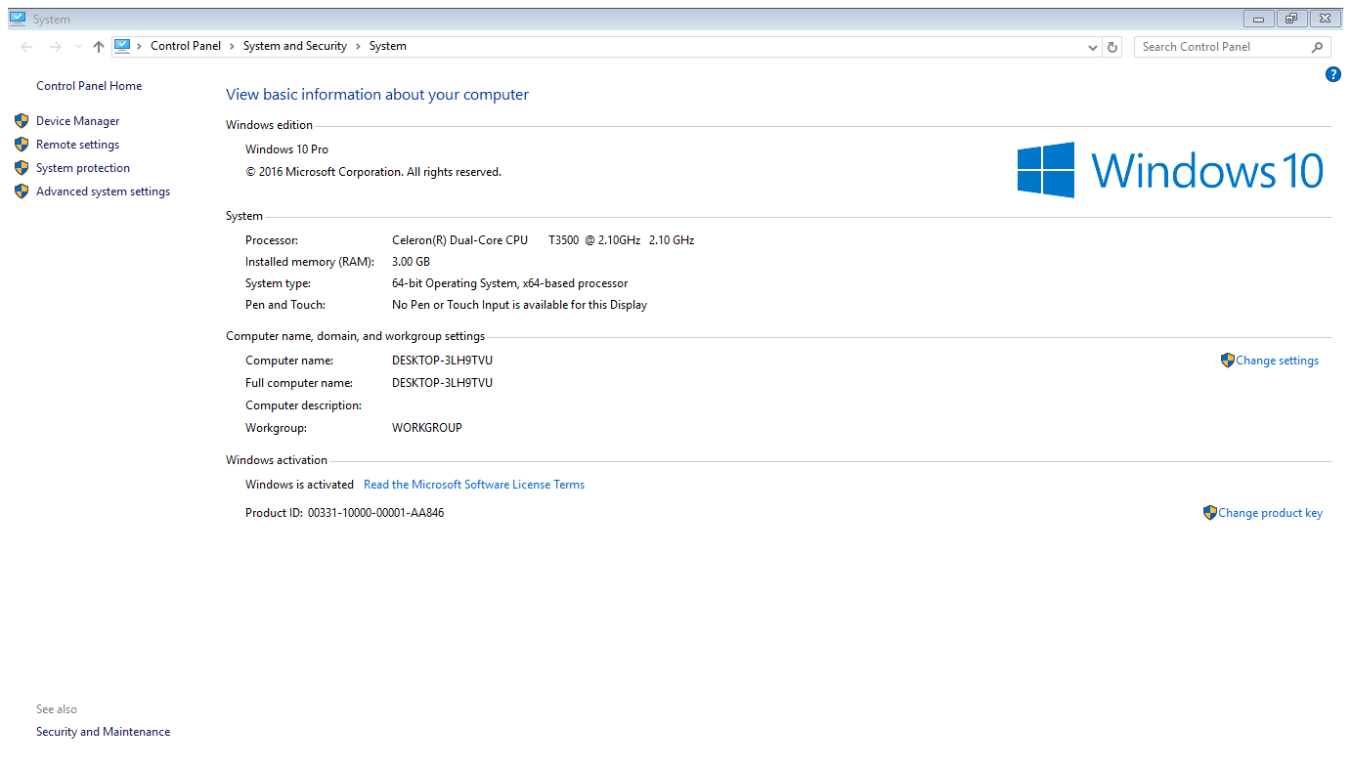

Slide 15
Alternatively you can go to
- This PC in windows 10 environment
right click any where
click on properties showing system information.

Slide 16
CHECKING THE HARD DISK SIZE
To check hard disk sizes do the following;
➢ Double click my computer icon on the desktop
➢ In my computer window, right click the icon associated to your hard disk (s) and then select properties. Check the details shown below;

Slide 17
Importance of checking system properties
It is important to check system information before buying a computer or loading any software in an existing one because the system information determines the cost, performance and the software that can run in the computer

Slide 18
The following properties are generally true:
➢ The larger the Random Access Memory (RAM), the better the performance of a computer the and higher the cost .
➢ The larger the hard disk size of a computer, the larger the data the computer can store and the larger the software that can be installed on the computer. Larger hard disks also imply better performance and higher cost.
➢ The higher the cache memory of a computer, the faster the response time of the computer. Cache memory also has implications on the cost of the computer with higher cache implying higher cost.
The higher the processor speed, the higher the processing power of the computer and the higher the cost of the computer.

Slide 19
A BALANCED COMPUTER
There needs to be a balance in the system properties for good functioning of the computer.
A balanced computer means a computer that has a very high processing speed should have large RAM
Similarly, a very large RAM should have a large Hard disk for better performance of computer in terms of processing power.

